Slide 1
Hadoop PySpark -
Presentation on term deposit subscription
Presented by:
Pragati Awasthi

Slide 2

Will my client subscribe to term deposit?

Slide 3

Data Exploration
We have around 11,163 records and 16 variables including age, marital status, education, account balance, loan and so on…
No missing values
Balanced classes
9 (Categorical), 7 (Numerical) and Target: Deposit
Split the data in training (70%) and testing (30%)

Slide 4
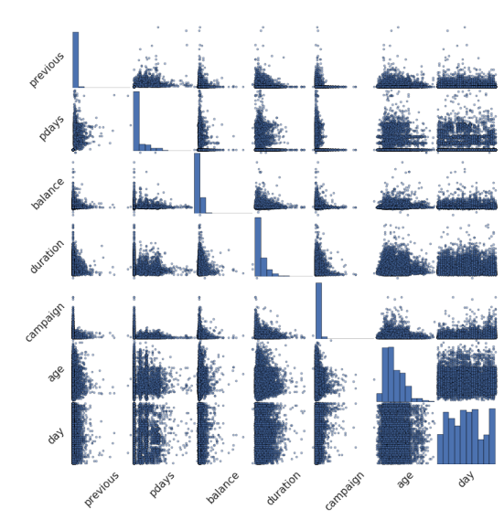
No high correlation among variables

Slide 5
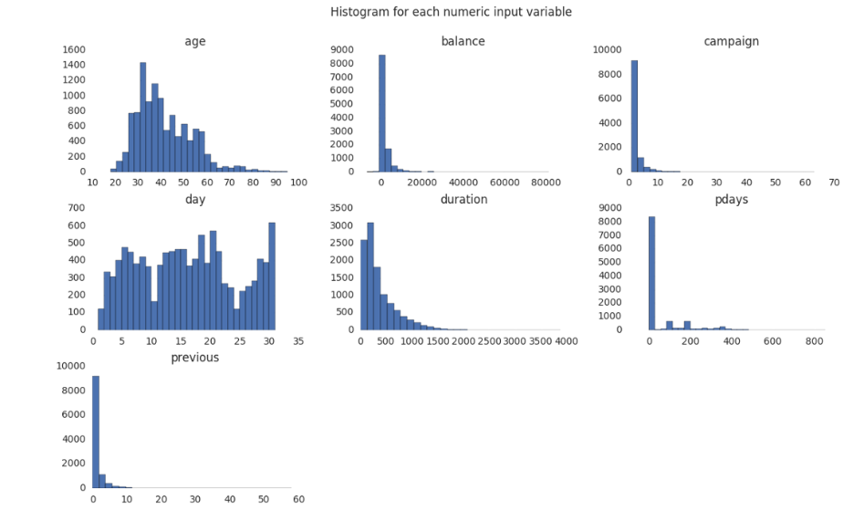
Histogram

Slide 6


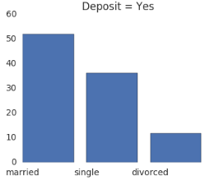
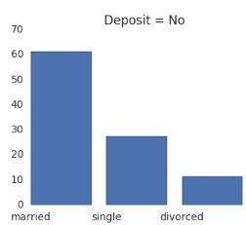
Marital vs Deposit (target variable)

Slide 7
Preparing data for Machine learning pipeline
String indexer for Categorical variables
One hot encoding for Numerical variables
Vector Assembler – merging multiple columns into single vector column
Create and fit the pipeline…..

Slide 8
Model Comparison
Training data : 7764 Test data : 3398
Model | Accuracy rate
Gradient Boosted Machine | 89.41%
Logistic Regression | 88.58%
Random Forest | 88.47%
Decision Tree | 78.07%
Gradient Boosting performed best of all!!!!!

Slide 9
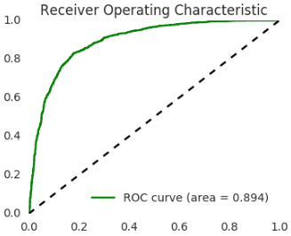
ROC Curve
Confusion Matrix:
 | Predicted
Actual | 1456 | 306
 | 297 | 1339
True Positive rate
False Positive rate

Slide 10
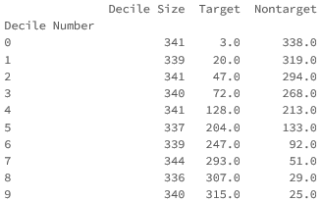
Decile analysis
Lower 5 deciles have the maximum targets

Slide 11
Thank You

